Slide 1

Integrated Project–II | Progress Review –1
Automatic Plant Disease Detection Using Image Processing
Department of Computer Science & Engineering
CHITKARA UNIVERSITY, HIMACHAL PRADESH
Submitted To: | Submitted By:
Ms. Tanu Minhas | 1. Ravi Kumar (2411981457)
 | 2. Saksham Yadav(2411981485)
 | 3. Ritish Sharma (2411981466)

Slide 2
Agenda
Project Overview
Requirement Gathering & Data Collection
Design Phase
Development Kickoff
SDG Goals Mapping
Multidisciplinary Approach
Novelty Factor
Challenges & Risks

Slide 3
Project Overview
Problem statement: Farmers often find it difficult to identify plant diseases at an early stage. Late detection can reduce crop quality and yield. A smart system is needed to automatically detect plant diseases using images of leaves.
Objective: To develop a system that detects plant diseases from leaf images using image processing or machine learning and helps farmers take early action.
Scope:
Detect diseases from plant leaf images.
Use image processing / machine learning techniques.
Provide disease name or detection result.

Slide 4
Stakeholders:
Students and developers working on smart agriculture
Farmers
Agricultural researchers
Agriculture departments

Slide 5
Requirement Gathering & Data Collection
Sources of Data:
Plant leaf images collected from datasets and online sources.
Agricultural research papers and literature review.(An Overview of the Research on Plant Leaves Disease detection using Image Processing Techniques )
Observation of diseased plant leaves.
Existing Datasets / Literature Review
Public datasets like Plant Village dataset used for training.
Previous research on plant disease detection using machine learning and image processing.
Functional Requirements
Upload plant leaf image.
Detect disease from the image.
Display disease result to the user and Suggested Fertilizer

Slide 6
Non-Functional Requirements
Easy to use interface.
Fast and accurate detection.
Reliable system performance.
Challenges in Data Collection
Getting high-quality leaf images.
Different lighting and background conditions.
Similar appearance of some diseases.
Current Status of Project:
Dataset collected and studied.
Basic model and research completed.
System development and testing in progress.

Slide 7
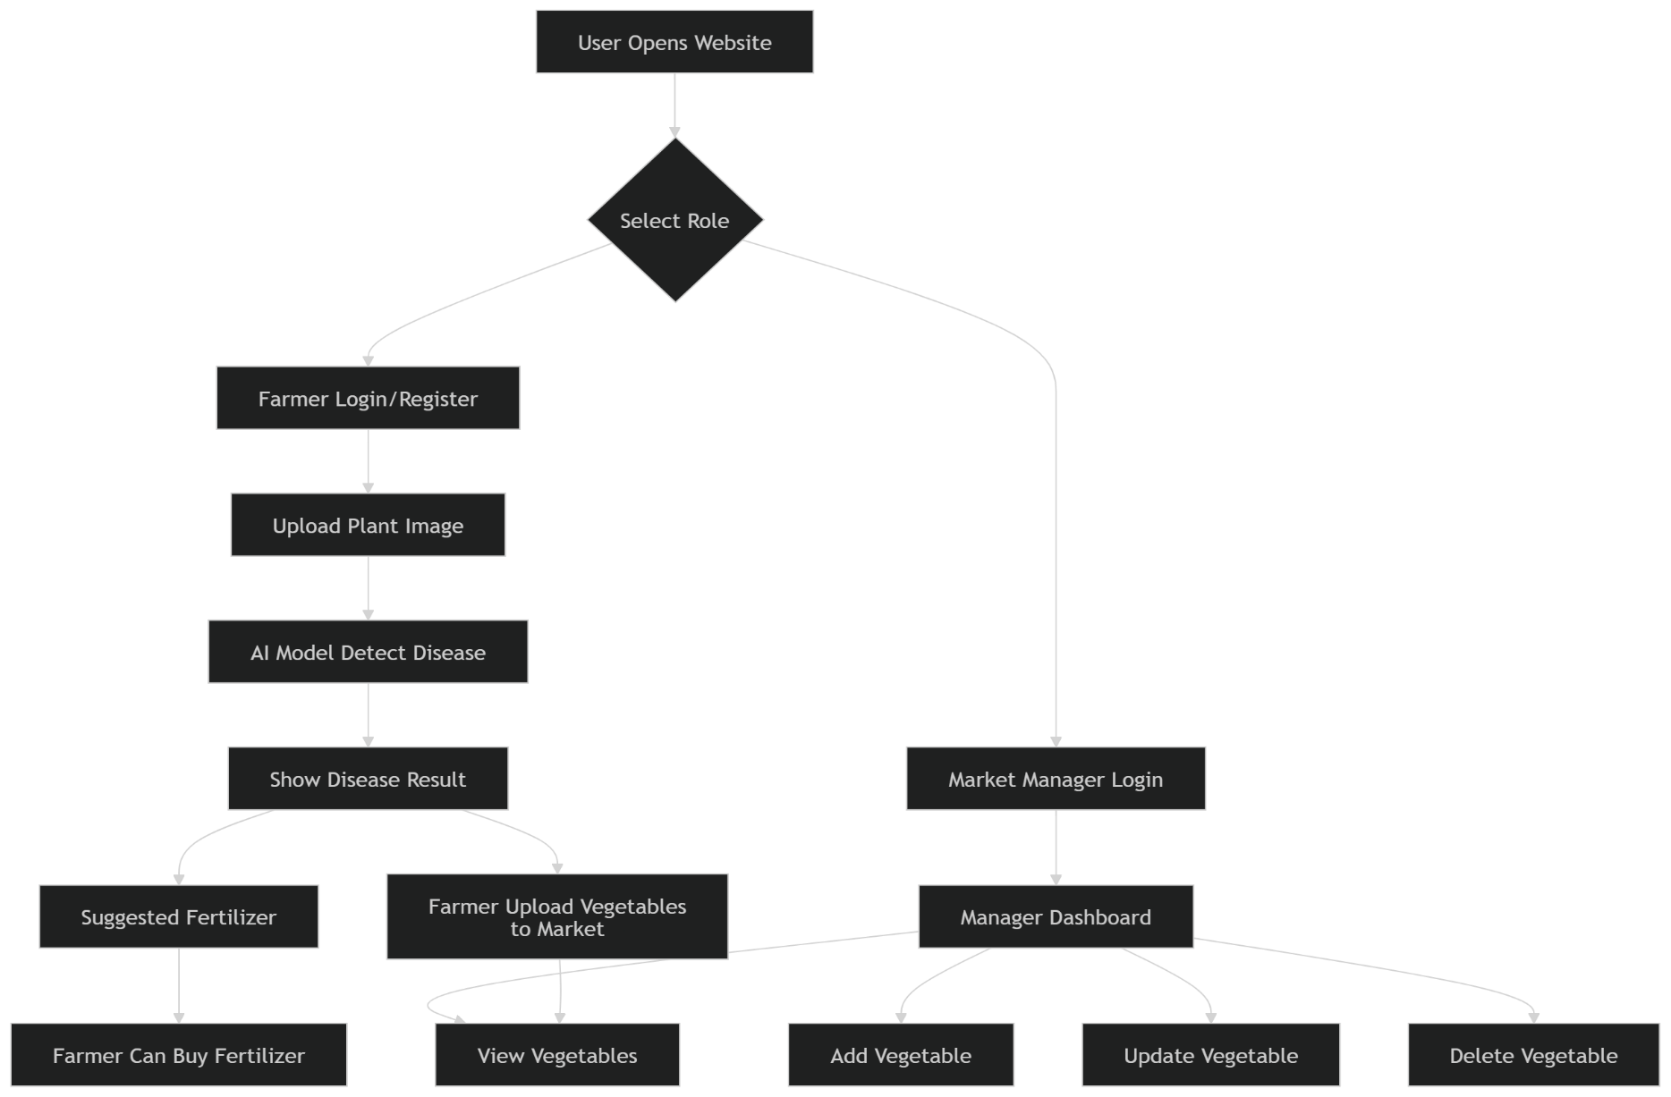
Design Phase
Use Case Diagram

Slide 8
Data Flow Diagrams (DFDs)
Farmer → Image Upload
System → Disease Result
Manager → Manage Vegetables
Architecture & Tech Stack
Frontend (User Interface)
Backend (Server Logic)
AI Model (Disease Detection)
Database (Store Data)

Slide 9
Development Kickoff
Initial Codebase Setup
Project environment and tools setup.
Required libraries installed (Python, TensorFlow / OpenCV).
Dataset loaded and organized.
Basic model structure created for plant disease detection.
Initial testing of the system started.

Slide 10
SDG Goals Mapping
SDG 2 – Zero Hunger: Helps improve crop production by detecting plant diseases early.
SDG 12 – Responsible Consumption and Production: Reduces crop loss and promotes efficient use of agricultural resources.
SDG 15 – Life on Land: Supports healthy plant growth and sustainable farming.
Potential Impact
Helps farmers identify plant diseases quickly.
Reduces crop damage and improves productivity.
Saves time and cost in manual disease detection.

Slide 11
Contribution to Sustainability and Social Good
Promotes smart agriculture using technology.
Supports sustainable farming practices.
Improves food security and farmers’ livelihood.

Slide 12
Multidisciplinary Approach
Fields Involved:
Artificial Intelligence / Machine Learning: Used to detect plant diseases from leaf images.
Data Science: Used for dataset collection, analysis, and model training.
Team Collaboration
Team members work together on data collection, model development, and testing.
Tasks are divided such as research, coding, dataset preparation, and documentation.
Interdisciplinary Innovation
Combines technology and agriculture to solve real farming problems.
Uses AI and data analysis to create a smart solution for plant disease detection.

Slide 13
Novelty Factor
What Makes This Project Unique
Uses AI / Machine Learning to detect plant diseases automatically.
Faster and more accurate than manual disease identification.
Can help farmers detect diseases at an early stage.
Shows nearest market prices, Helps farmers compare and choose the best market
Comparison with Existing Solutions
Traditional method: Farmers identify diseases manually which takes time and may be inaccurate.
Proposed system: Image-based automatic detection using machine learning for better accuracy and speed, Shows nearest market prices, Helps farmers compare and choose the best market

Slide 14
Challenges & Risks
Key Challenges Faced So Far
Difficulty in collecting high-quality plant leaf images.
Different lighting conditions and backgrounds in images.
Some plant diseases look very similar, making detection difficult.
Limited dataset for certain plant diseases.
Identified Risks & Mitigation Strategies
Incorrect disease prediction.
Insufficient or unbalanced dataset.
Model accuracy issues.

Slide 15
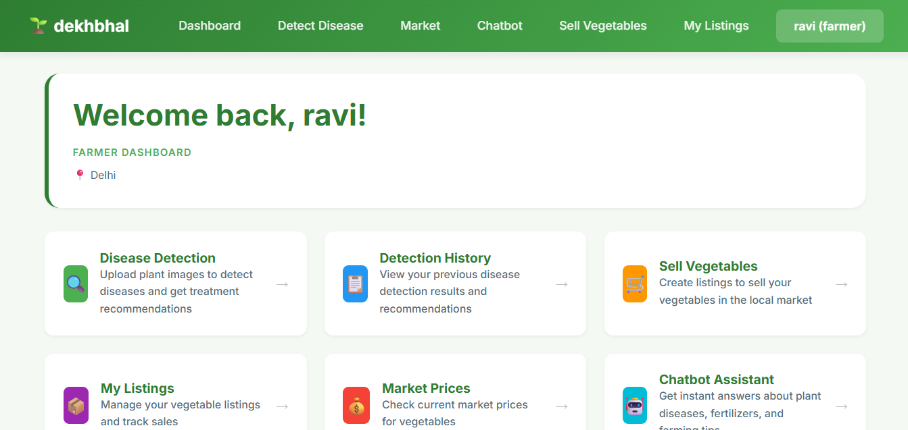
Slide 12: Snapshots of Project Implementation

Slide 16
Thank You

